Slide 1
Part I: StreetRx exploring heterogeneity in pricing of morphine by location
Team 3 Green
Abhijith Tammanagari, Clarissa Ache, Marlyne Hakizimana, Shufan Xia, Tigran Harutyunyan

Slide 2
Data & project objective
MH
Launched in 2010, StreetRx.com is a crowdsourced price data collection tool of many pharmaceutical substances.
We will use Morphine for this study.
Available in multiple countries but we will only focus on US States and Territories
Variables obtained:
We will use a multi-level model to investigate factors related to the price per mg of Morphine, accounting for potential clustering by location and exploring heterogeneity in pricing by location.
Variable Name | Type | Description
USA_region | Categorical | Based on state and coded as Northeast, Midwest, West, South, or Other/unknown
state | Categorical | US States and Territories (i.e. Puerto Rico, Guam, etc.) “USA” = “Unknown”
city | (not used) | Manually entered by user and not required
source | Categorical, 5 levels | Source of information; allows users to report purchases they did not personally make "Heard it” (baseline), "Personal", "Internet", "Internet Pharmacy", "Unknown"
form_temp | Binary | 0 = pill/tablet, 1 = suppository
mgstr | Numeric, discrete | Dosage strength in mg of the units purchased
bulk_purchase | Binary | 0 = Not bulk purchase, 1= Bulk purchase
ppm | Numeric, continuous (response variable) | Price per mg
Natural Hierarchy!
Form_fac Variable
Levels | Count
1 = Pill/Tablet | 8717
2 = Suppository | 5 (Only 5!)

Slide 3
About the data: Response variable
MH
Response variable, Price per mg (ppm), did not follow a Normal distribution
On average, the Price per mg in this data is $ 0.54
Min = $ 0.0001
Max = $ 40.00

Slide 4
About the data: LOCATION GROUPING
ABI
Differences in Price per mg (ppm) are more visible when grouped by State compared to Region
(Sample)

Slide 5
About the data: predictors
ABI
Median Price per mg of Morphine (ppm) seems to be very similar whether purchased in bulk or not
There seems to be a slight variation in magnitude by State, but the trend is consistent: Bulk morphine is cheaper
(Sample)

Slide 6
About the data: predictors
ABI
Concentration (mgstr) variable does seem to have an effect on Price (ppm)
The trend is consistent across states and territories, but it seems like the slope varies
(Sample)

Slide 7
Model building & VALIDATION
SX
Clean the data
Removed all observations that had missing values (NAs) for ppm
Fit a linear model
Validated assumptions
Checked for outliers and multicollinearity
Fit a hierarchical linear model
Tested if grouping by Region helped explain variation better
Tested in random slopes helped explain variation better
Selected variables using Stepwise with AIC
Validated selected variables were significant
Adjusted missing values
Removed obs with Price (ppm) = 0
Example: changed state=‘USA’ to ‘Unknown’
Tried transformations for the response variable: sqrt, quadratic, etc.
It did not!
1
2
3

Slide 8
Model & Findings
SX
Linear mixed model fit by REML ['lmerMod']
Formula: logppm ~ mgstr_c + bulk_fac + source_fac + (mgstr_c | state)
Data: streetrx_morphine
Scaled residuals:
Min | 1Q | Median | 3Q | Max
-8.30 | -0.45 | 0.10 | 0.61 | 4.58
Random effects:
Groups | Name | Variance | Std.Dev. | Corr.
state | (Intercept) | 0.014 | 0.120
 | mgstr_centered | 0.008 | 0.088 | 0.27
Residual |  | 0.813 | 0.902
Number of obs: 8722, groups: state, 56
Fixed effects:
 | Estimate | Std. Error | T-value | 95% Confidence Interval
(Intercept) | -0.93 | 0.03 | -30.83 | -0.99 | -0.87
mgstr_centered | -0.32 | 0.02 | -18.04 | -0.36 | -0.29
Bulk: Yes | -0.11 | 0.03 | -4.06 | -0.16 | -0.05
Source: Internet | 0.00 | 0.06 | 0.04 | -0.11 | 0.11
Source: Internet Pharmacy | -0.32 | 0.09 | -3.59 | -0.49 | -0.15
Source: Personal | -0.07 | 0.03 | -2.61 | -0.13 | -0.02
Source: Unknown | -0.04 | 0.03 | -1.58 | -0.10 | 0.01
WHERE IS THE VARIATION IN PRICE COMING FROM?
In our model, only 19% of the variation in Price is attributed to the location (U.S. States and Territories).
Which means, the price of morphine doesn’t really vary that much across states and territories.
WHAT IS THE AVERAGE PRICE OF MORPHINE ANYWHERE IN THE U.S.?
The average price per mg of Morphine in any of the 56 U.S. States and Territories is exp(-0.93) = $ 0.39
Notes:
Holding all variables at the baseline, employees who received the training would have an increase in the difference in wage between 1974-1978 of ~$2573. That is significant evidence that employees who receive the training tend to earn higher wages than workers who do not receive job training.
Wight 95% confidence, the increase in wage difference is between ~$ 1075 and $ 3170.
Being married has a negative effect of about $1800 in the wage difference between those years (holding all other variables at the baseline).
Age also has a negative effect in the wage difference. For each additional year of age, the wage difference is approx.. $ 202 less
However, considering an employee who did receive training, for each year he ages, he will have + $ 2573 - $ 202 + $ 295 = $ 2666 extra wage compared to an employee who is not getting trained and has the average age, 27 y/o, (intercept since we centered age), keeping other variables constant.

Slide 9
Model & Findings
CA
Linear mixed model fit by REML ['lmerMod']
Formula: logppm ~ mgstr_c + bulk_fac + source_fac + (mgstr_c | state)
Data: streetrx_morphine
Scaled residuals:
Min | 1Q | Median | 3Q | Max
-8.30 | -0.45 | 0.10 | 0.61 | 4.58
Random effects:
Groups | Name | Variance | Std.Dev. | Corr.
state | (Intercept) | 0.014 | 0.120
 | mgstr_centered | 0.008 | 0.088 | 0.27
Residual |  | 0.813 | 0.902
Number of obs: 8722, groups: state, 56
Fixed effects:
 | Estimate | Std. Error | T-value | 95% Confidence Interval
(Intercept) | -0.93 | 0.03 | -30.83 | -0.99 | -0.87
mgstr_centered | -0.32 | 0.02 | -18.04 | -0.36 | -0.29
Bulk: Yes | -0.11 | 0.03 | -4.06 | -0.16 | -0.05
Source: Internet | 0.00 | 0.06 | 0.04 | -0.11 | 0.11
Source: Internet Pharmacy | -0.32 | 0.09 | -3.59 | -0.49 | -0.15
Source: Personal | -0.07 | 0.03 | -2.61 | -0.13 | -0.02
Source: Unknown | -0.04 | 0.03 | -1.58 | -0.10 | 0.01
WHAT IS THE PRICE OF MORPHINE IN A PARTICULAR STATE?
For a particular state (e.g. North Carolina), the difference from the “grand intercept” of all US states and territories is -0.046 (in log scale)
North Carolina’s average price of Morphine is $ 0.38 (slightly less than the average)
On average, the price of morphine goes down when the concentration increases. In NC, the multiplicative effect of a unit increase in concentration of the drug is exp(-0.386) = 0.68. That’s a decrease in Price (ppm) of 32%
 | (Intercept) | mgstr_centered
North Carolina | -0.046 | -0.066
Notes:
Holding all variables at the baseline, employees who received the training would have an increase in the difference in wage between 1974-1978 of ~$2573. That is significant evidence that employees who receive the training tend to earn higher wages than workers who do not receive job training.
Wight 95% confidence, the increase in wage difference is between ~$ 1075 and $ 3170.
Being married has a negative effect of about $1800 in the wage difference between those years (holding all other variables at the baseline).
Age also has a negative effect in the wage difference. For each additional year of age, the wage difference is approx.. $ 202 less
However, considering an employee who did receive training, for each year he ages, he will have + $ 2573 - $ 202 + $ 295 = $ 2666 extra wage compared to an employee who is not getting trained and has the average age, 27 y/o, (intercept since we centered age), keeping other variables constant.

Slide 10
Model & Findings
CA
Random Effects for each U.S. state or territory in average price per mg of Morphine (ppm) and the effect of Concentration (mgstr_c)
WHICH STATES HAVE HIGHER AND LOWER PRICES OF MORPHINE?
 | State / Territory | (Intercept)
Top 4 | Massachusetts | $ 0.47
 | Tennessee | $ 0.47
 | West Virginia | $ 0.46
 | Oklahoma | $ 0.44
Bottom 4 | Arizona | $ 0.34
 | Illinois | $ 0.34
 | California | $ 0.31
 | Michigan | $ 0.31
HOW DOES THE PRICE CHANGE BY CONCENTRATION (mgstr_c) IN DIFFERENT STATES?
State / Territory | Effect of Concentration (mgstr)
Massachusetts | 0.78
Tennessee | 0.77
West Virginia | 0.70
Oklahoma | 0.73
Arizona | 0.71
Illinois | 0.66
California | 0.71
Michigan | 0.69
https://www.drugabuse.gov/drug-topics/opioids/opioid-summaries-by-state

Slide 11
Model & Findings
CA
WHICH STATES HAVE HIGHER AND LOWER PRICES OF MORPHINE?
 | State / Territory | (Intercept)
Top 4 | Massachusetts | $ 0.47
 | Tennessee | $ 0.47
 | West Virginia | $ 0.46
 | Oklahoma | $ 0.44
Bottom 4 | Arizona | $ 0.34
 | Illinois | $ 0.34
 | California | $ 0.31
 | Michigan | $ 0.31
HOW DOES THE PRICE CHANGE BY CONCENTRATION (mgstr_c) IN DIFFERENT STATES?
State / Territory | Effect of Concentration (mgstr)
Massachusetts | 0.78
Tennessee | 0.77
West Virginia | 0.70
Oklahoma | 0.73
Arizona | 0.71
Illinois | 0.66
California | 0.71
Michigan | 0.69
Notes:
Holding all variables at the baseline, employees who received the training would have an increase in the difference in wage between 1974-1978 of ~$2573. That is significant evidence that employees who receive the training tend to earn higher wages than workers who do not receive job training.
Wight 95% confidence, the increase in wage difference is between ~$ 1075 and $ 3170.
Being married has a negative effect of about $1800 in the wage difference between those years (holding all other variables at the baseline).
Age also has a negative effect in the wage difference. For each additional year of age, the wage difference is approx.. $ 202 less
However, considering an employee who did receive training, for each year he ages, he will have + $ 2573 - $ 202 + $ 295 = $ 2666 extra wage compared to an employee who is not getting trained and has the average age, 27 y/o, (intercept since we centered age), keeping other variables constant.

Slide 12
Model limitations & Next steps
TH
There is still variation that we cannot explain by grouping by state or territory
There are more variables that explain variation and we are not including in this model
It is plausible that the normality assumption is satisfied. However, we have seen better QQ Plots.
Different transformations of the response variable did not achieve any improvements
More complicated transformation may have improved the Normality but we would have lost interpretation power (ex: double square root)
The relationship between mgstr (concentration) and Price may not be perfectly linear
The are no dose values from 120 to 200 mg
Residuals are clustered around a range of values (-1.5, -1.0)
https://www.drugabuse.gov/drug-topics/opioids/opioid-summaries-by-state

Slide 13
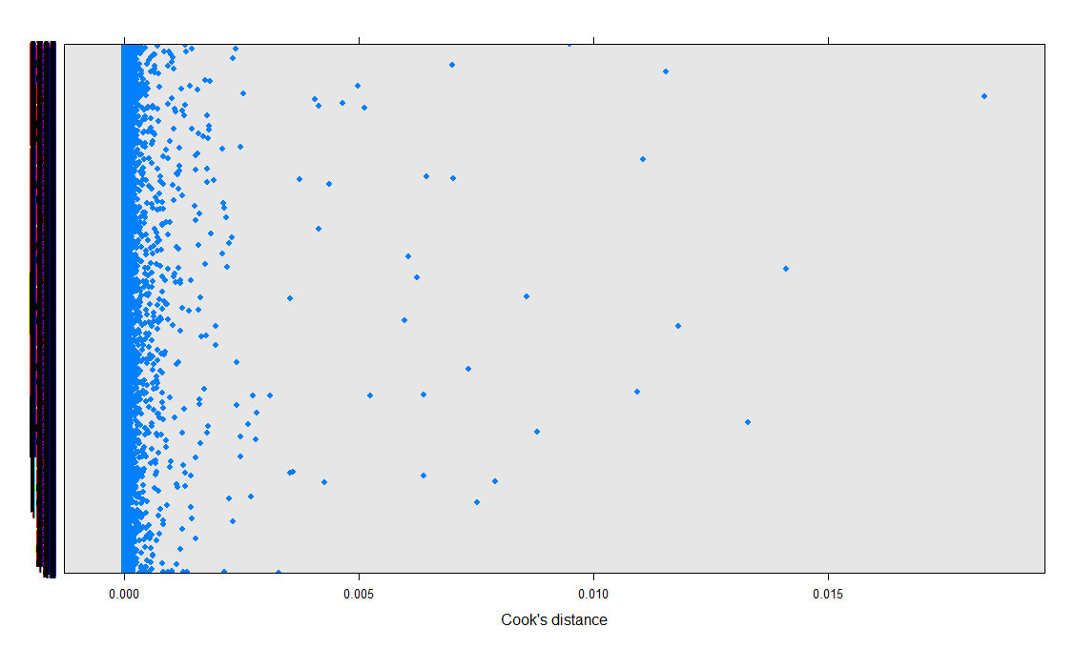
Outliers
The Cook’s Distance for all points is still below the 0.2 threshold
Cook’s Distance – Final Model

Slide 14
Model assessment
Again, the response variable looks roughly Normal. Normality assumption is still plausible.

Slide 15
Model assessment
Residuals vs. Fitted Values – Final Model
Looking at the residuals of the final model, although they do look random, they seem to be concentrated around (-.1.5, -1.0) of the fitted values
Clustering suggests we may need additional variables or a different model to better explain the behavior of this data.

